Slide 1

Digital Marketing Project Phase 2
Comprehensive Digital Marketing For Mother Dairy

Slide 2
CONTENT OF THIS PRESENTATION
INDEX
SI No | PARTICULARS
Chapter One | Brand Study, Competitor Analysis & Buyer’s/Audience’s Persona
Chapter Two | SEO & Keyword Research
Chapter Three | Content Ideas And Marketing Strategies
Chapter Four | Content Creation And Curation
CONCLUSION | Power Point Presentation Conclusion
Faculty Guid: K . JAGAN MOHAN
SSR DEGREE COLLEGE
Team Members: NIKHIL KOLASANI , KOLLU SOWMYA VANI , VINNAKOTA HARIKA , YERUVA SAIBALA DHARNESWAR

Slide 3
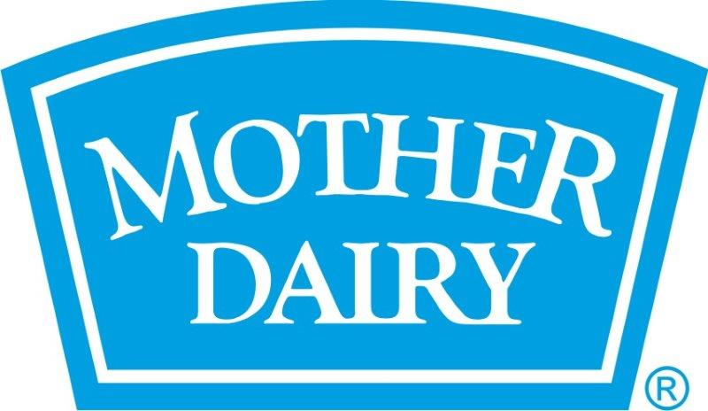
MOTHERS DAIRY
For Now we are Examine the this particular Company for this project this Company in India that manufactures the Milk Products which has a Major Share in Milk Dairy Products.

Slide 4
01
Chapter One

Slide 5
Brand Study, Competitor Analysis & Buyer’s/Audience’s Persona
Research Brand Identity
Competitor Analysis
Buyer's/Audience's Persona

Slide 6

Research Brand Identity
Mission/Values:
Commitment to Quality – Mother Dairy ensures that their products maintain high quality.
Consumer Trust – They continually aim to be a brand that consumers trust for everyday products.
Farmer Welfare – Mother Dairy prioritizes the welfare of the farmers who are at the heart of their supply chain.

Slide 7
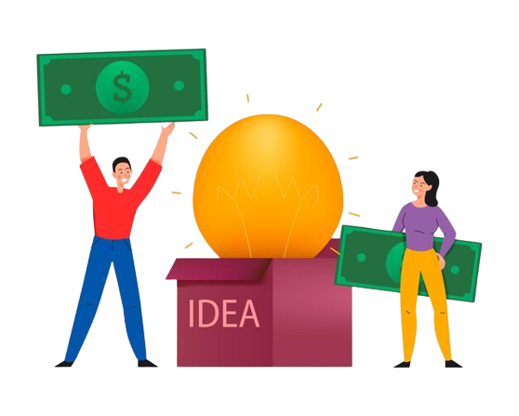
Unique Selling Point :
Freshness and Purity: Mother Dairy is renowned for delivering fresh and pure dairy products directly from farms to consumers.
Farm to Fridge: Their integrated model of sourcing directly from farmers and then distributing products ensures minimal time between milk collection and it reaching the consumer, maintaining the products freshness.

Slide 8

Analyze Brand Tone and Identity
Mother Dairy has used taglines such as "Happy Food, Happy People" which reiterates their commitment to providing quality food products that bring happiness and satisfaction to consumers.

Slide 9
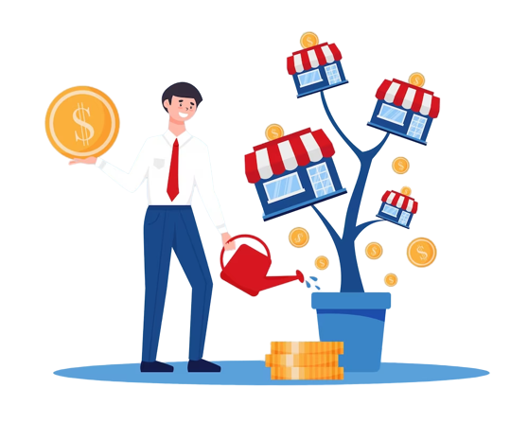


KEY PERFORMANCE INDICATOR
IDEA 01
IDEA 03
IDEA 02
Goal: Enhance online engagement by growing Mother Dairy's social media followers on its primary platform by 25% in the next 8 months.
KPI: Monitor the monthly increase in the number of followers on the chosen social media platform, ensuring a consistent upward trajectory towards the 25% target.
Goals : Increase the sales of probiotic yogurt by 15% over the next 12 months
KPI : Track monthly sales figures of probiotic yogurt and monitor the accumulated increase over the 12-month period.
Goal: Expand the retail presence of Mother Dairy products to 200 new stores in untapped regions within the next 6 months.
KPI: Maintain a monthly log of the number of new stores carrying Mother Dairy products and ensure a minimum addition of around 33 stores each month.

Slide 10
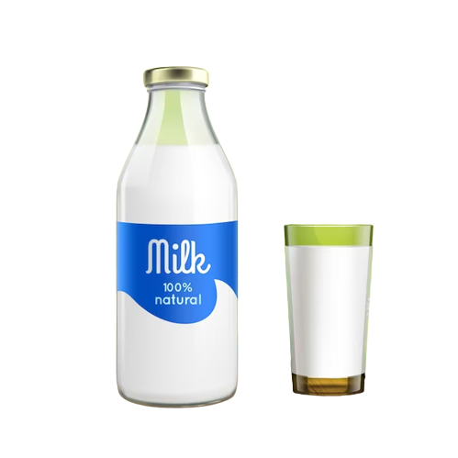

KEY PERFORMANCE INDICATOR
IDEA 04
IDEA 05
Goal: Introduce three new flavored milk products and achieve a distribution in at least 70% of existing retail outlets within 4 months.
KPI: Track the number of retail outlets carrying the new flavored milk products each month, aiming for the 70% distribution mark by the end of the 4th month.
Goal: Reduce product complaints related to packaging by 50% in the next 10 months.
KPI: Monitor the number of complaints received specifically related to packaging each month and compare it to the baseline from the previous months to ensure a declining trend towards the 50% reduction.

Slide 11
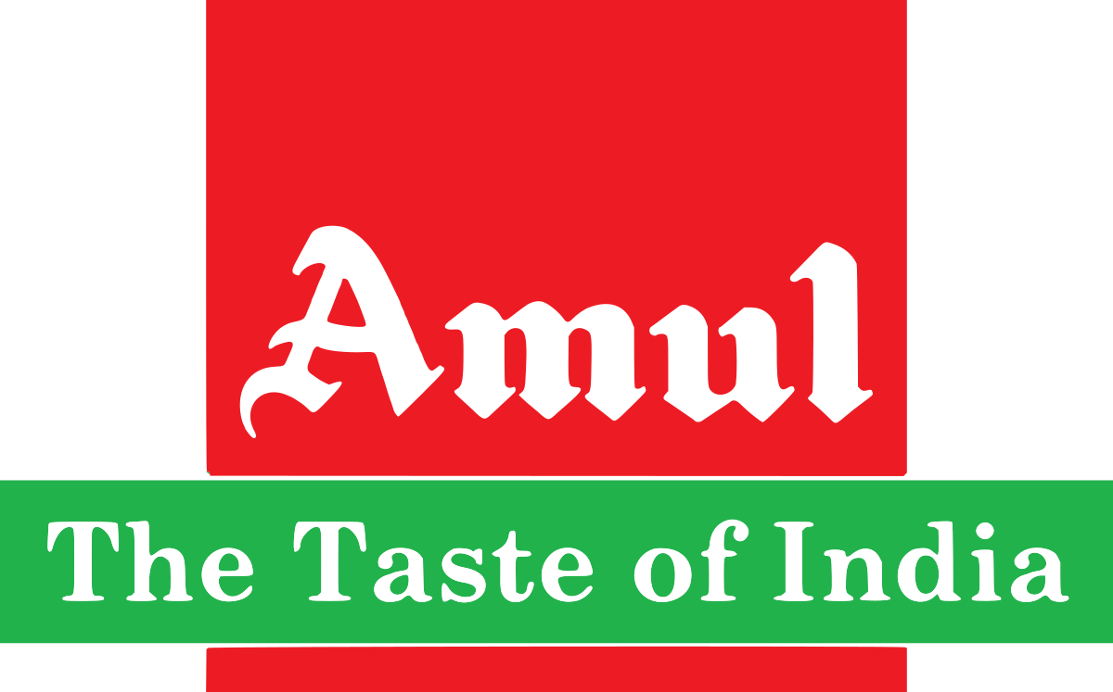

COMPETITOR ANALYSIS
AMUL
BRITANNIA
USP (Unique Selling Proposition)
Diversity of Products: Amul has a wide range of dairy products, from milk to ice cream, cheese, chocolates, and more.
Trust and Purity: Known as the "Taste of India", Amul has a strong reputation for quality and authenticity.
Cooperative Model: Sourcing directly from farmers, emphasizing its cooperative model that supports local dairy farmers.
Online Communication:
Interactive Website: Detailed product information, recipes, and dairy industry insights.
Strong Social Media Presence: Engaging advertisements, often revolving around current affairs, shared across platforms like Twitter, Instagram, and YouTube.
USP:
Diverse Dairy Portfolio: Known for its cheese, ghee, and yogurt, but also for bakery products like biscuits and cakes.
Quality and Taste: Emphasis on international standards of quality and unique flavors.
Online Communication:
Engaging Website: Provides information on new product launches and corporate initiatives.
Active Social Media: Uses platforms like Instagram, Twitter, and Facebook to engage with consumers, often with interactive contests and campaigns.

Slide 12
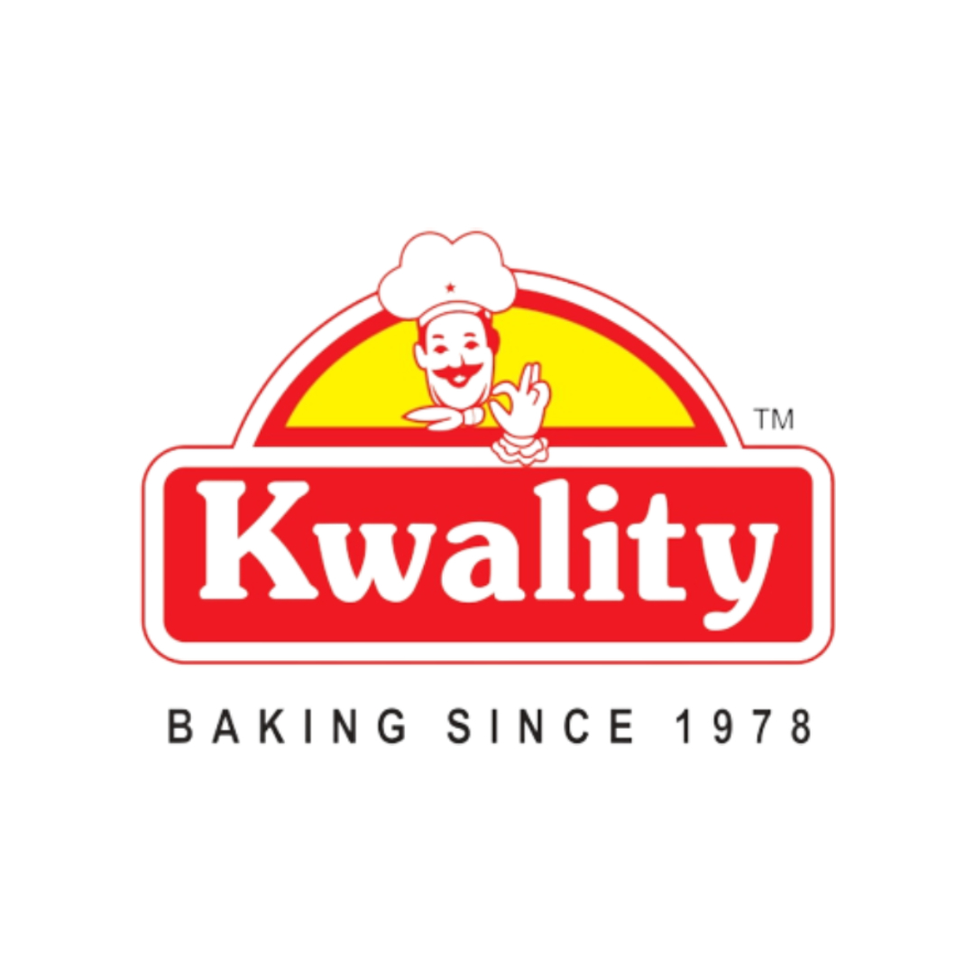
COMPETITOR ANALYSIS
KWALITY
USP:
Variety in Milk Products: Offers a range of milk products, from full cream to toned milk, ghee, and curd.
Focus on Health: Markets its products emphasizing health benefits, especially for growing children.
Online Communication:
User-friendly Website: Focus on product benefits and health aspects.
Social Media Engagement: Regular posts about product features, health benefits, and consumer engagement.

Slide 13

SWOT ANALYSIS
Mother Dairy
Strengths:
Strong brand reputation in Northern India.
Wide distribution network.
Diverse range of dairy products.
Weaknesses:
Limited international presence.
Dependence on local markets.
Opportunities:
Expansion to southern and western Indian markets.
Launch of dairy alternatives (e.g., almond, oat milk).
Threats:
Intense competition from local and national brands.
Price volatility in the dairy industry.
Amul
Strengths:
Highly diversified product range.
Strong cooperative model supporting Indian farmers.
Robust brand image and wide-scale recognition as the "Taste of India".
Weaknesses:
Challenges in maintaining consistent quality across such a diverse product range.
Over-reliance on the Indian market.
Opportunities:
International market expansion.
Tapping into dairy-alternative segments.
Threats:
Counterfeit products using the Amul name.
Price wars with other major dairy players.

Slide 14
SWOT ANALYSIS
Kwality Ltd
Strengths:
Emphasis on health benefits attracting health-conscious consumers.
Established brand in the dairy segment.
Weaknesses:
Limited diversification outside of dairy.
Less brand visibility compared to giants like Amul and Britannia.
Opportunities:
Collaborations with health and fitness brands.
Expansion into value-added dairy products with health benefits.
Threats:
Strong competition from other dairy brands focusing on health.
Challenges in differentiating in a saturated dairy market.

Slide 15
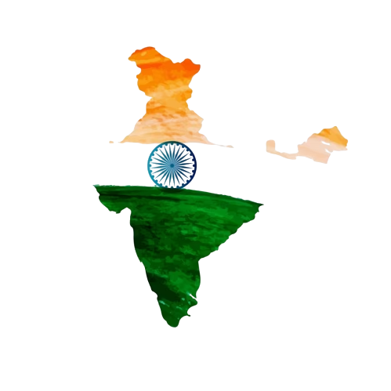
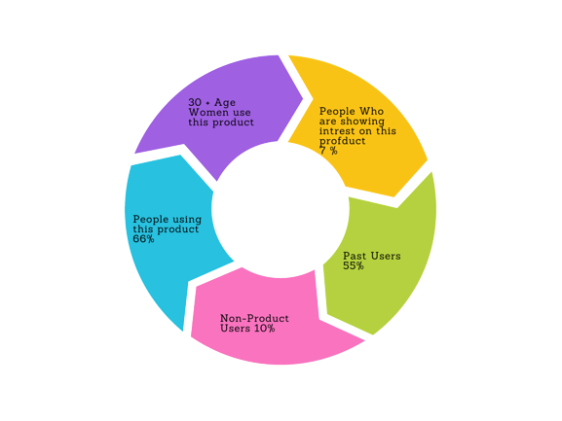
Buyer's/Audience's Persona
India reach report
50k liters
66%
20 Cr +
Per -Day
Market
Share
Number of Daily Customers
20+
States
7000+
franchises

Slide 16
Here's a generalized buyer's persona for Mother Dairy:
Persona Name: Priya
Demographics:
Age: 28-38 years
Gender: Female
Marital Status: Married with 1-2 children
Occupation: Homemaker or working in a corporate/teaching job
Income: Middle class (INR 6 lakh - 14 lakh per annum for the household)
Geography: Urban and suburban areas
Psychographics:
Prioritizes her family's health and nutrition.
Believes in giving the best quality food to her family.
Occasionally indulges in treats like ice cream or flavored milk.
Buying Motivations:
Daily need for milk and dairy products.
Trust in the brand for purity and quality.
Variety of products available for different family members (e.g., full cream milk for kids, low-fat for herself).
Purchasing Habits:
Regularly buys dairy essentials during weekly grocery shopping.
Influenced by quality, freshness, and brand trustworthiness.
May be influenced by promotions or discounts on certain products.
Persona Name: Ananya
Demographics:
Age: 22-28 years
Gender: Female
Marital Status: Single or recently married
Occupation: Young professional or postgraduate student
Income: Emerging middle class (INR 4 lakh - 8 lakh per annum)
Geography: Metro cities or university towns
Psychographics:
Lives a fast-paced life, often skipping breakfast or opting for quick meals.
Values convenience but also looks for healthy options.
Enjoys occasional indulgences like desserts or flavored yogurts.
Buying Motivations:
Need for quick and nutritious breakfast options.
Trust in established brands for dairy products.
Attractive packaging and new product innovations.
Purchasing Habits:
Often buys products on-the-go from local stores or kiosks.
Influenced by product freshness, expiration dates, and nutritional content.
Likely to try new products if they cater to her health and convenience needs.

Slide 17
02
Chapter Two

Slide 18
SEO & Keyword Research
SEO Audit
Keyword Research
On page optimization

Slide 19
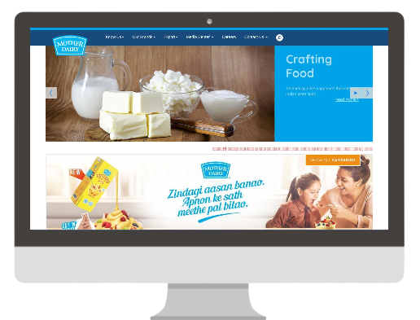

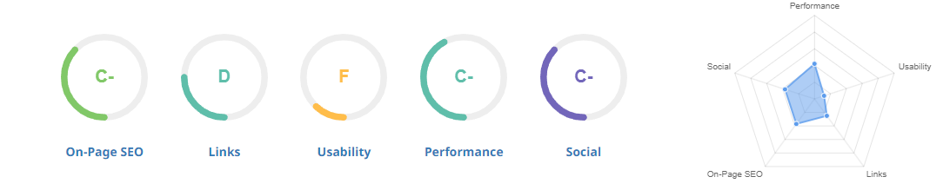
SEO AUDIT
D+

Slide 20
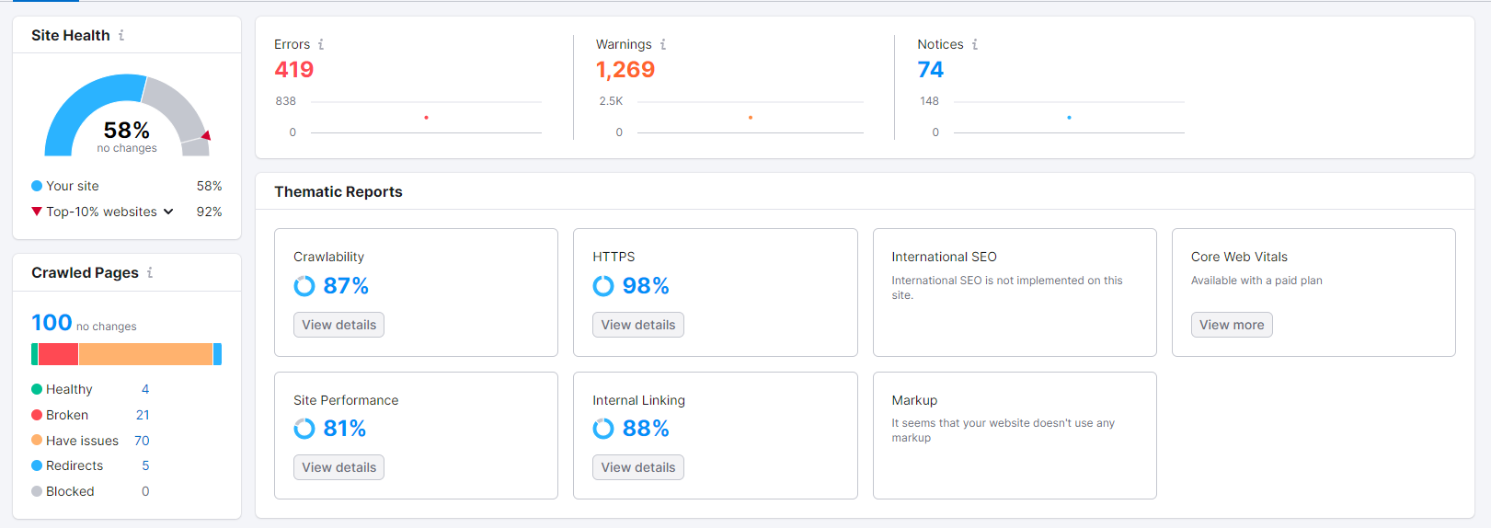

Slide 21
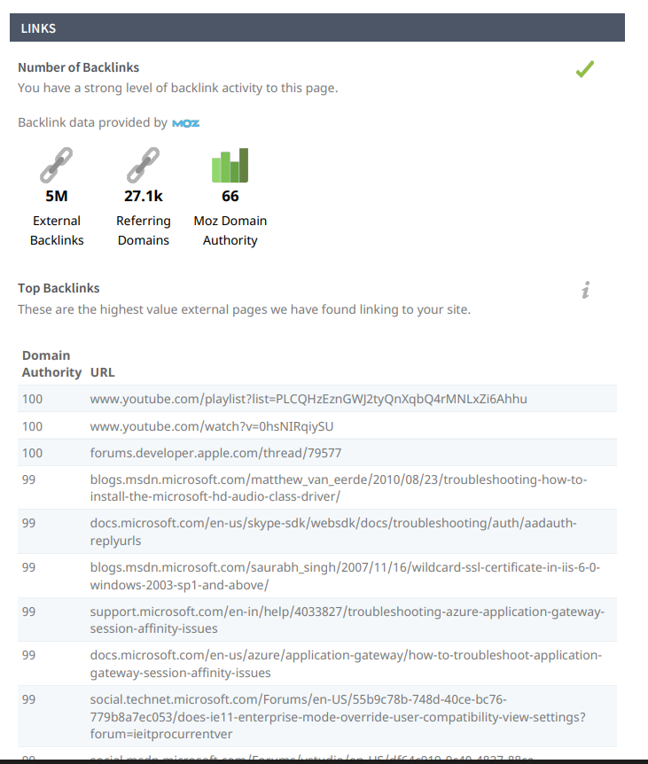
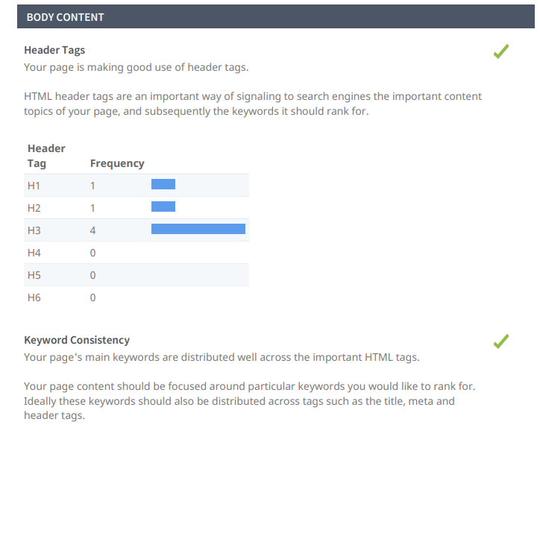

Slide 22
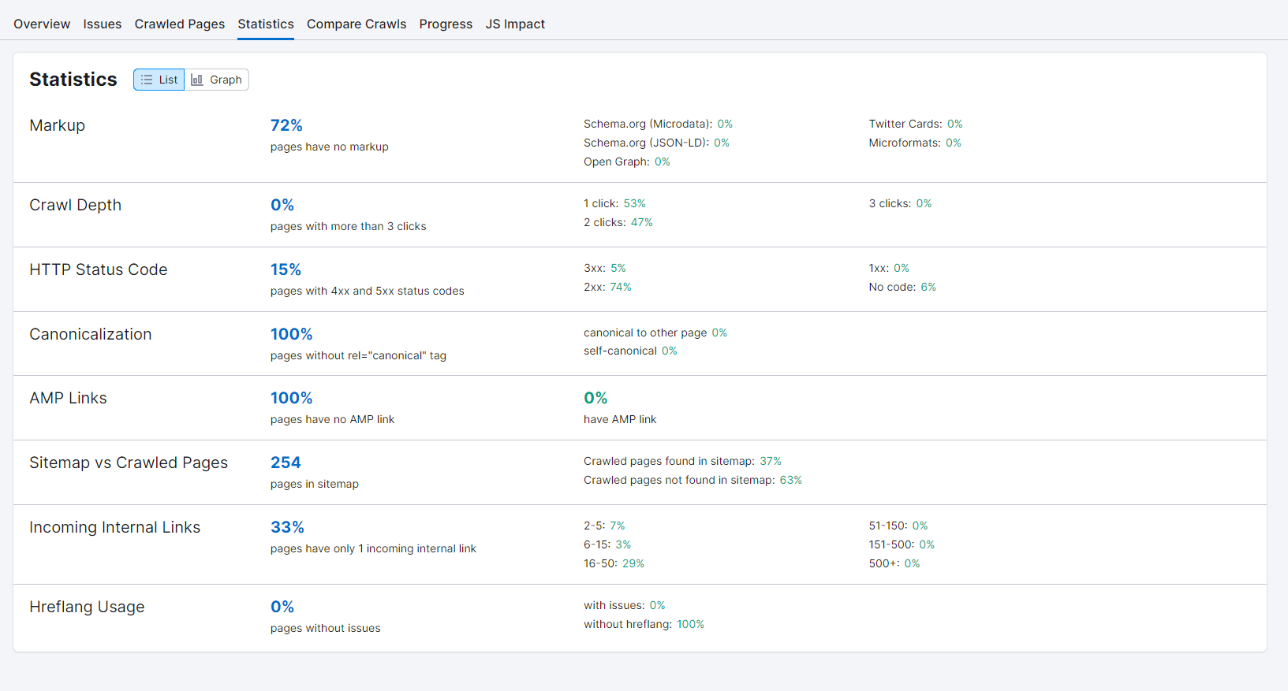

Slide 23
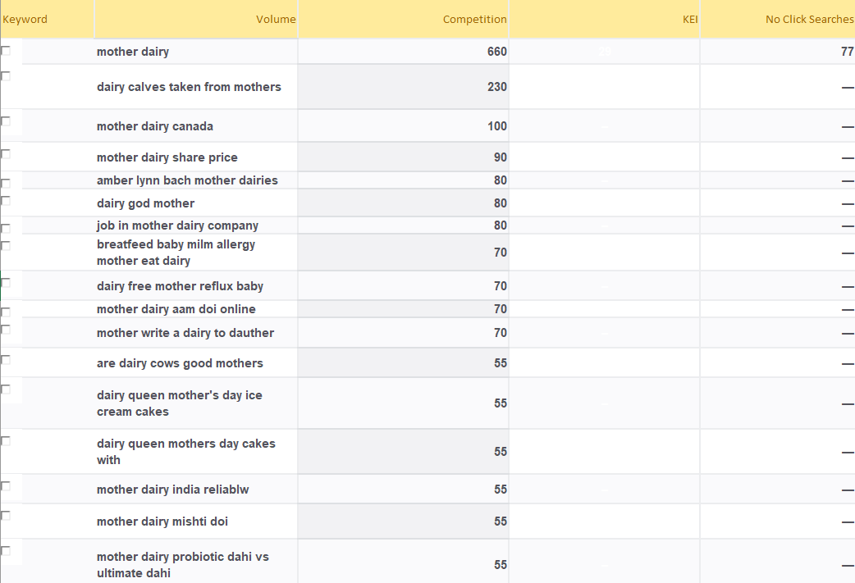
Keyword Research

Slide 24
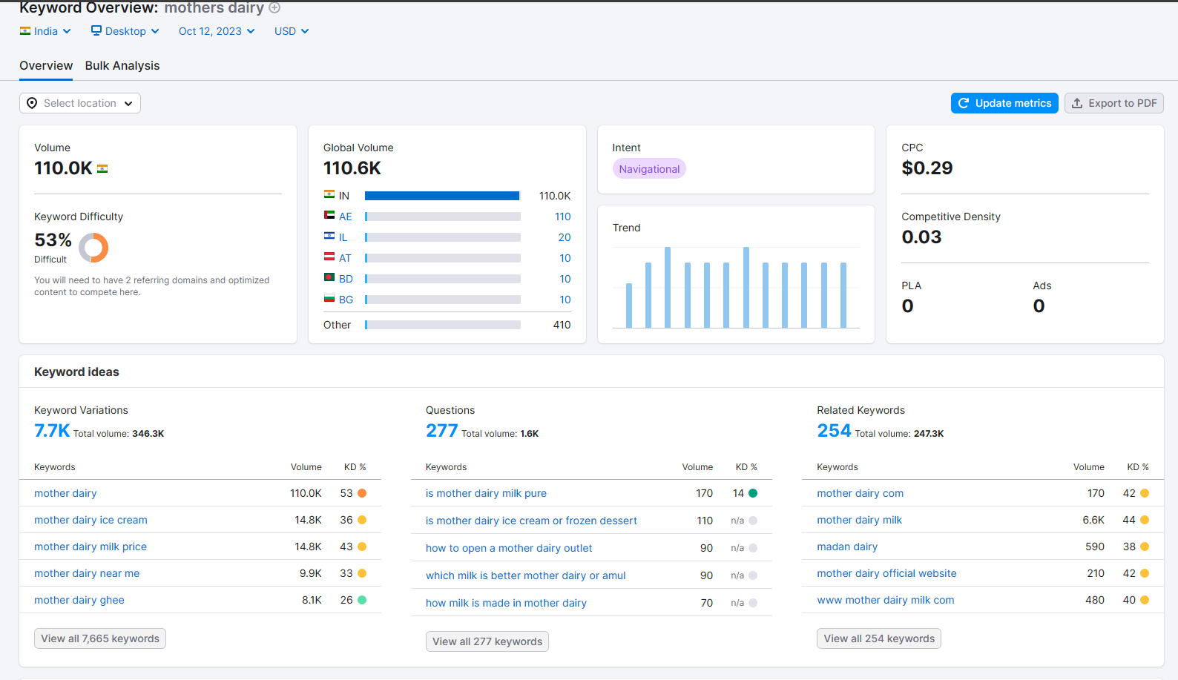
Utilize Keyword Research Tools

Slide 25
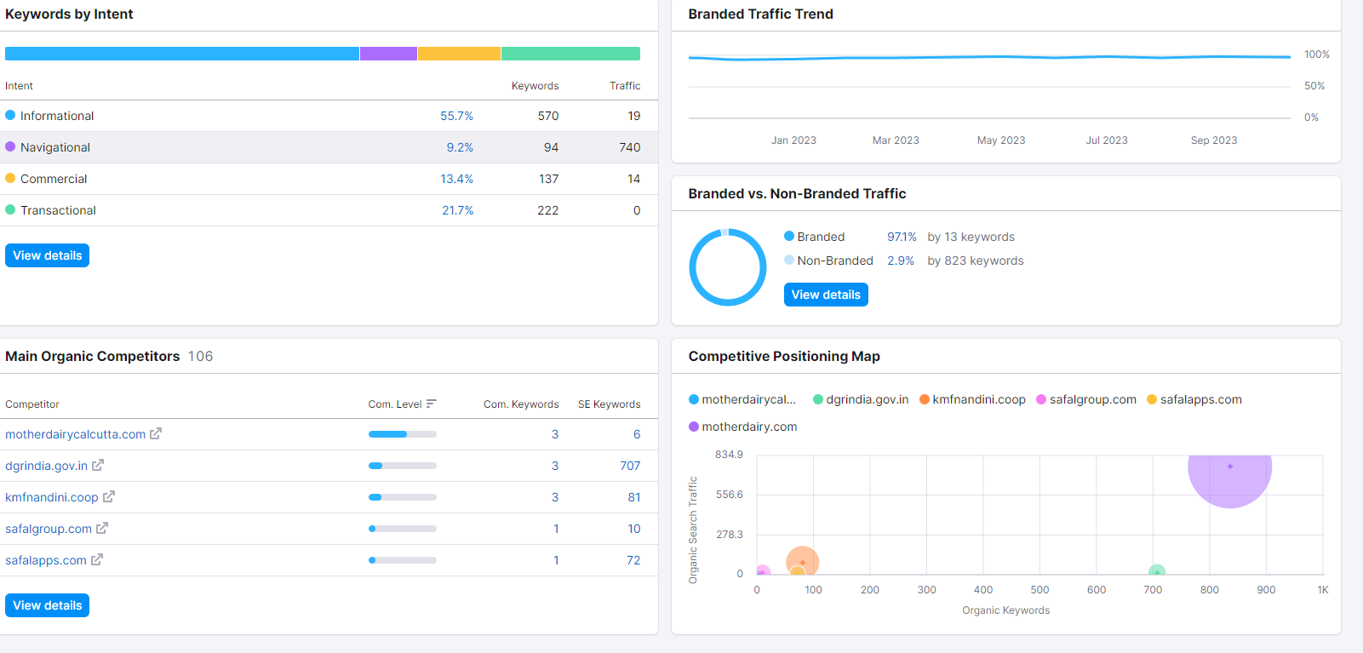
Analyze Competitor Keywords

Slide 26
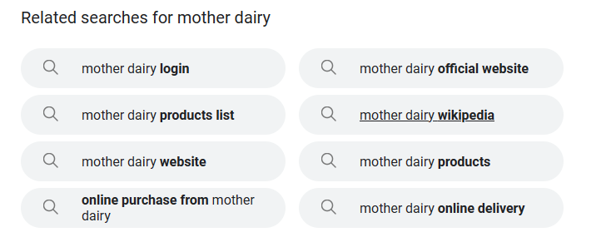
Long-tail Keyword Exploration

Slide 27
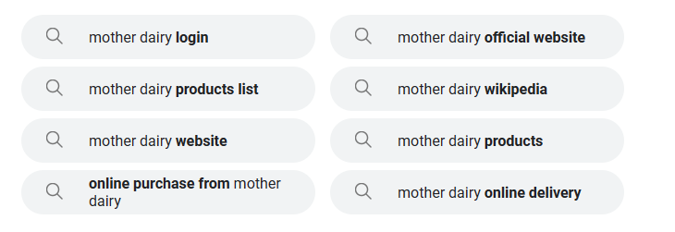
Long-tail Keyword Exploration

Slide 28
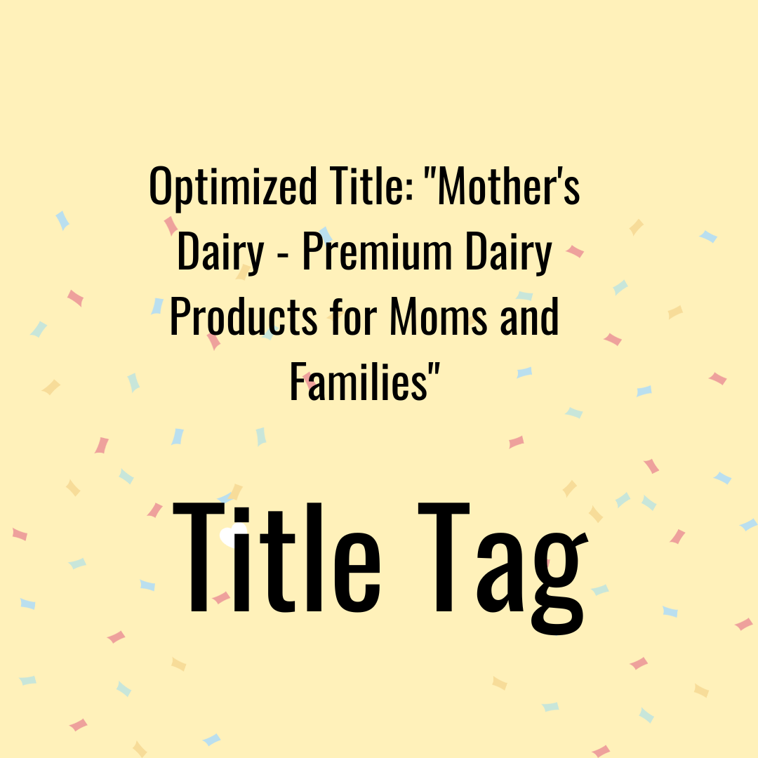
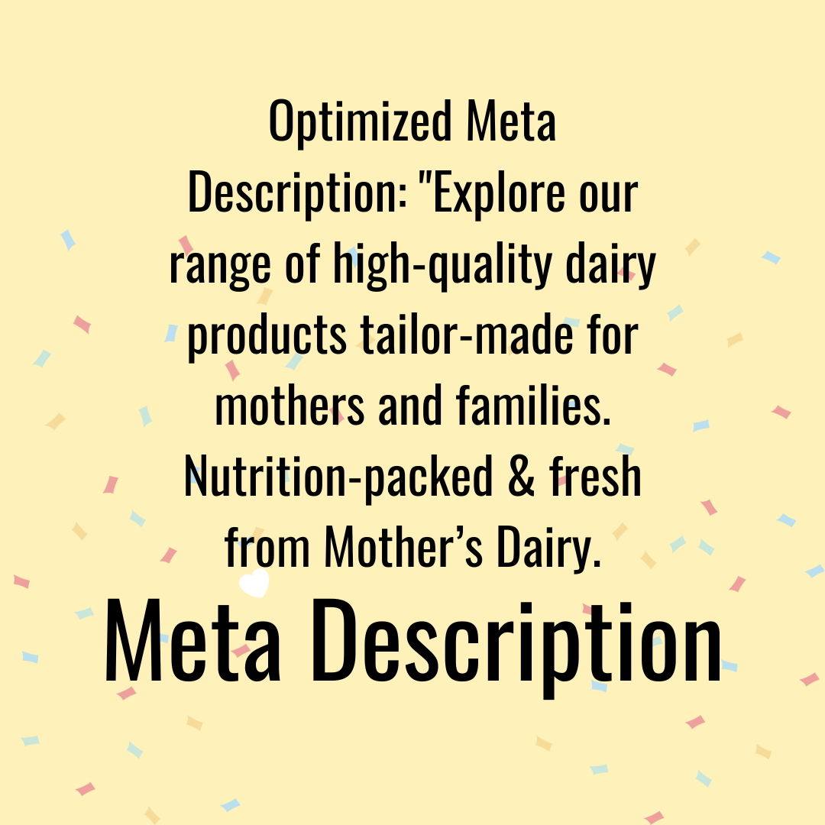
On Page Optimization
Meta Tag Optimization

Slide 29




Content Optimization
Content Optimization
Keyword Usage
Content Quality & Relevance
Mobile Optimization
Call-to-Action

Slide 30
03
Chapter Three

Slide 31
Content Ideas And Marketing Strategies
Content Idea Generation & Strategy
Marketing Strategies

Slide 32
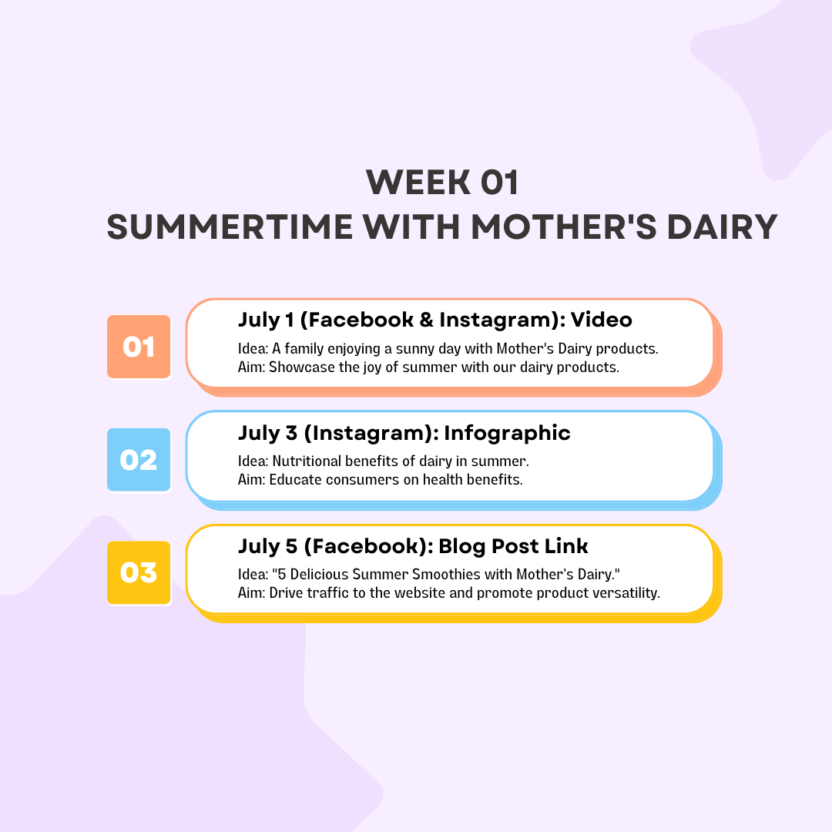
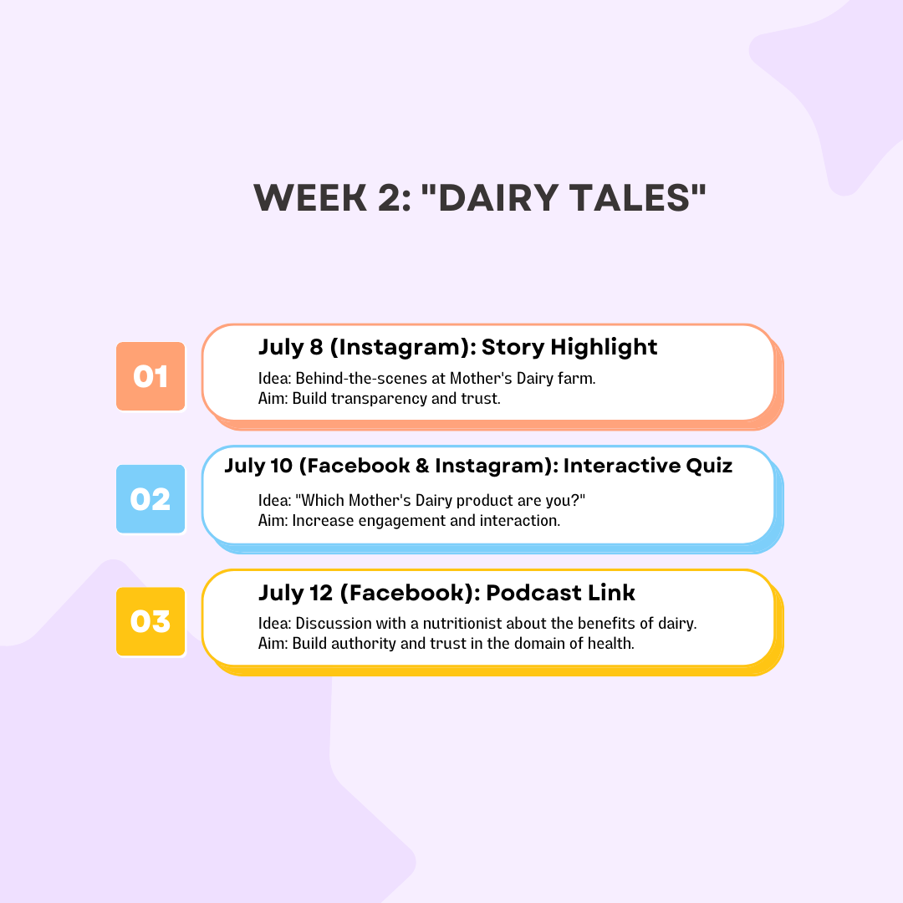
Content Idea Generation & Strategy
content calendar

Slide 33
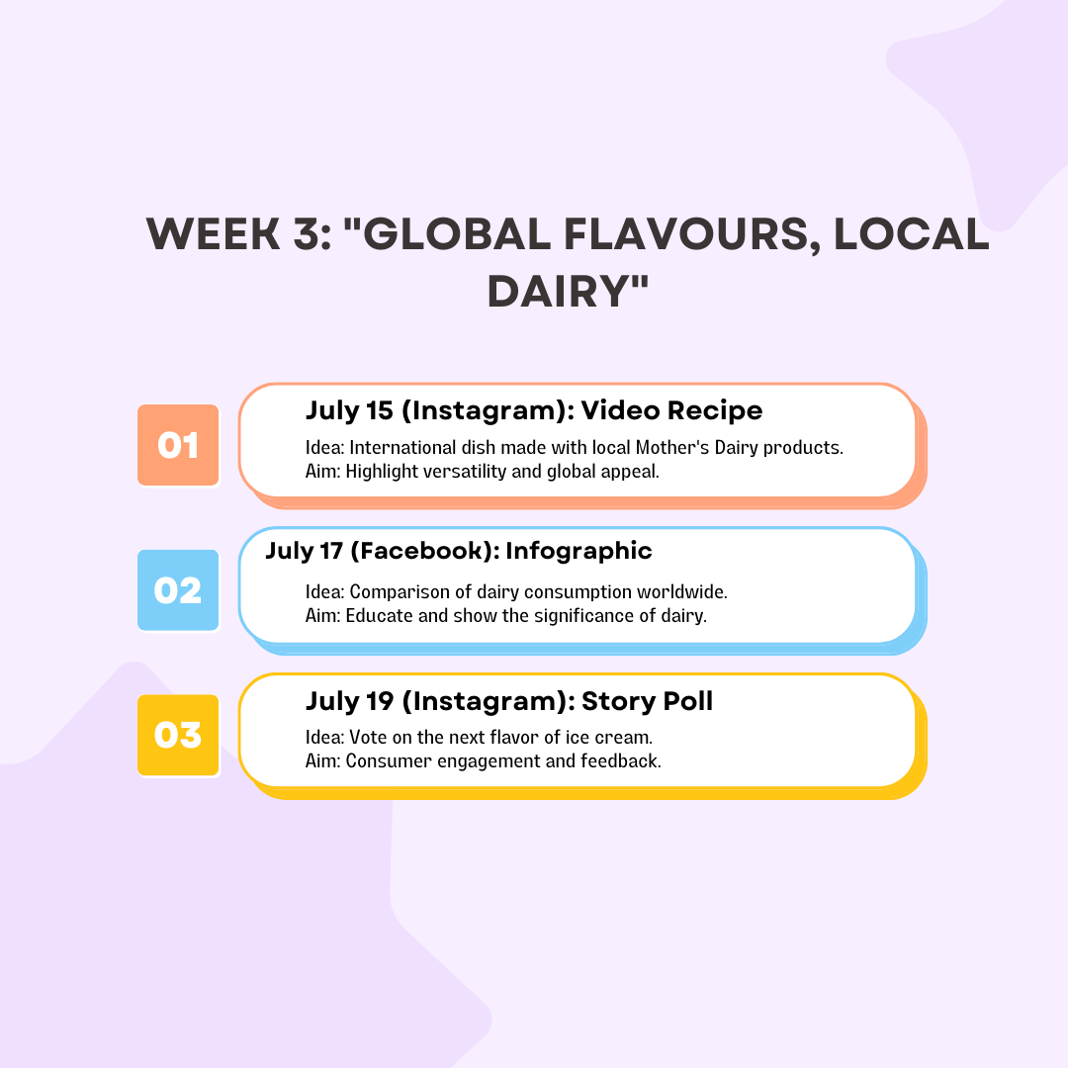
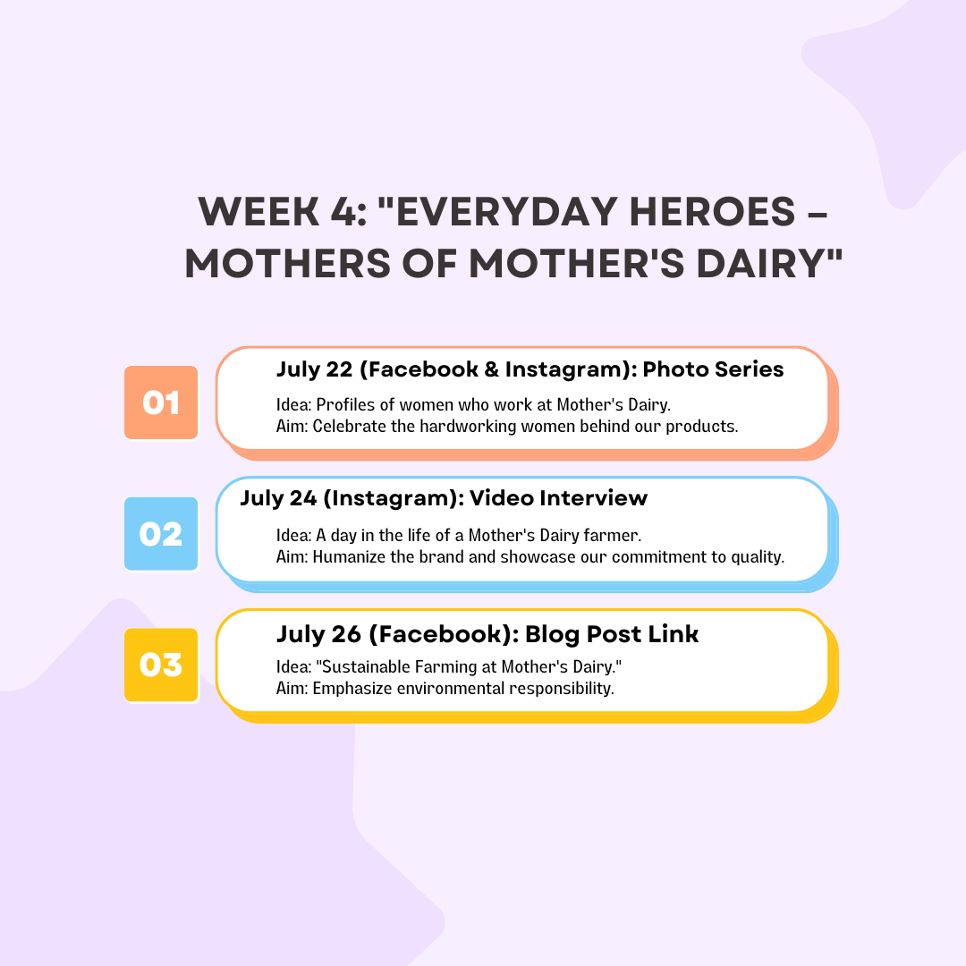
Content Idea Generation & Strategy

Slide 34
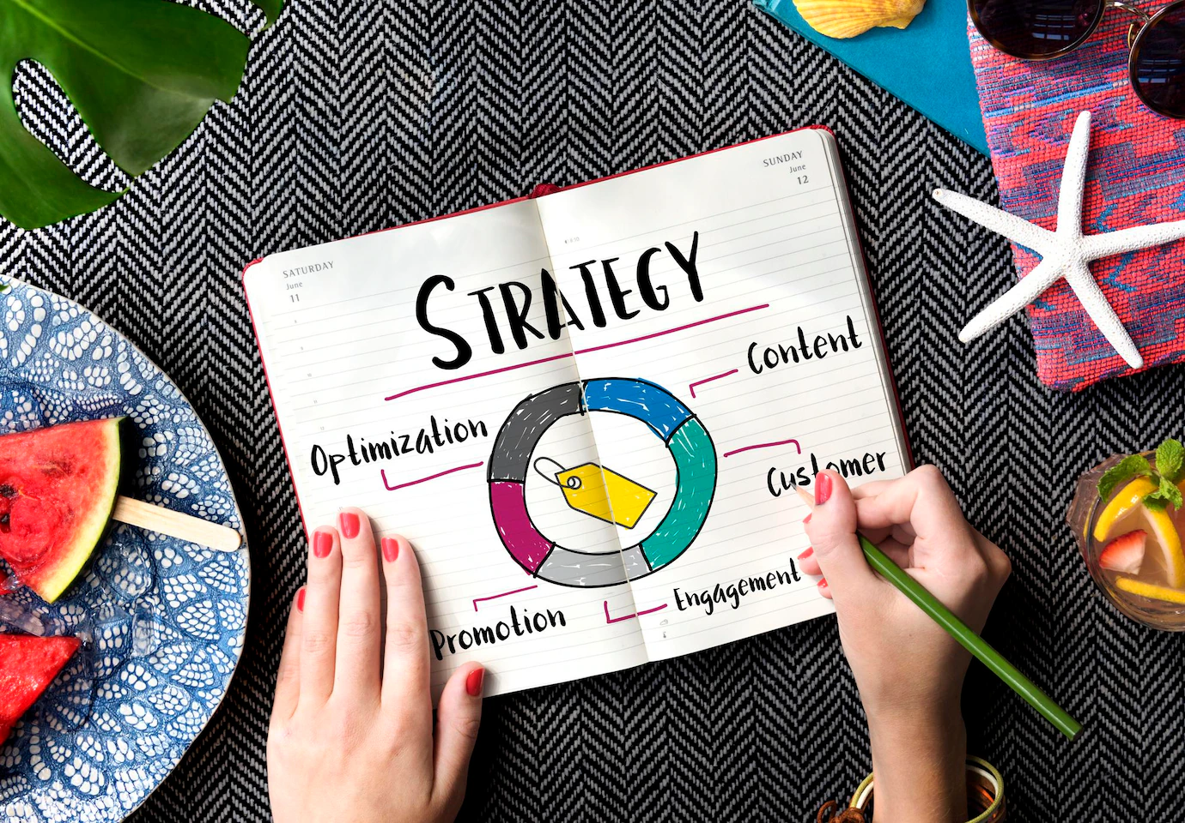
Marketing Strategies
Reflection on the Content Ideas
User Engagement
Storytelling Works
Consistency
Reflection on Marketing Strategies
Algorithm Challenges
Resource Allocation
Feedback

Slide 35



Reflection on the Content Ideas
User Engagement
Storytelling Works
Consistency

Slide 36


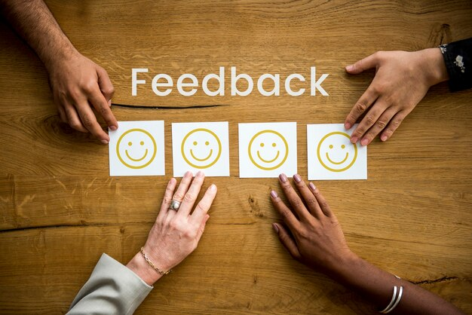
Reflection on Marketing Strategies
Algorithm Challenges
Resource Allocation
Feedback

Slide 37
04
Chapter Four

Slide 38
Content Creation And Curation
Post Creation
Designs/Video Editing
Social Media Ad Campaigns
Email Ad Campaigns

Slide 39
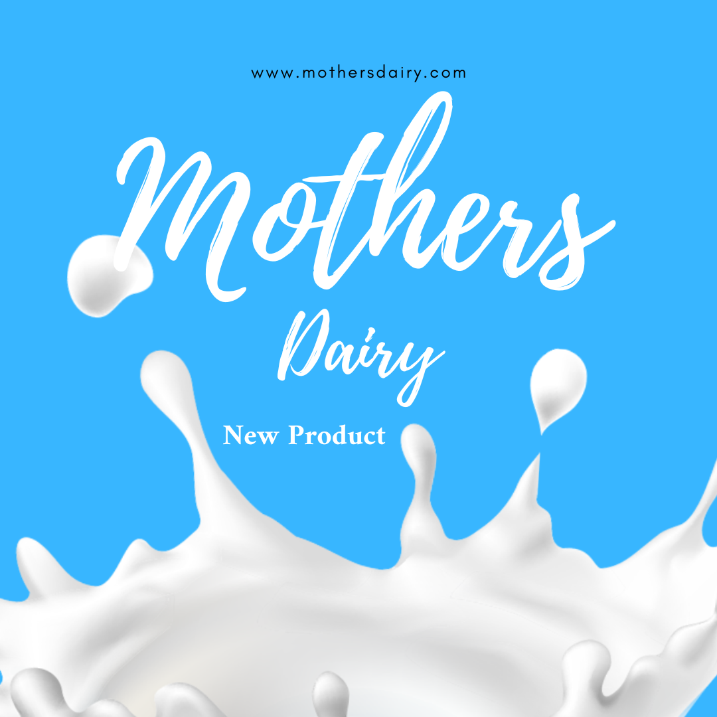
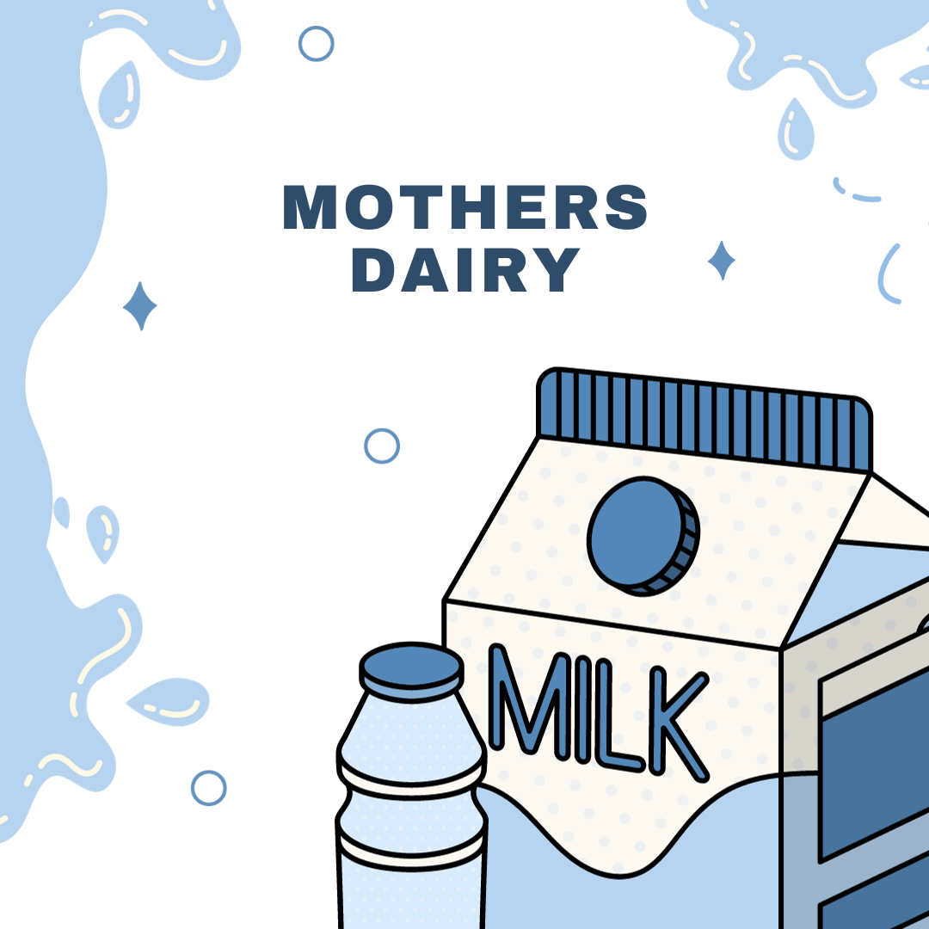
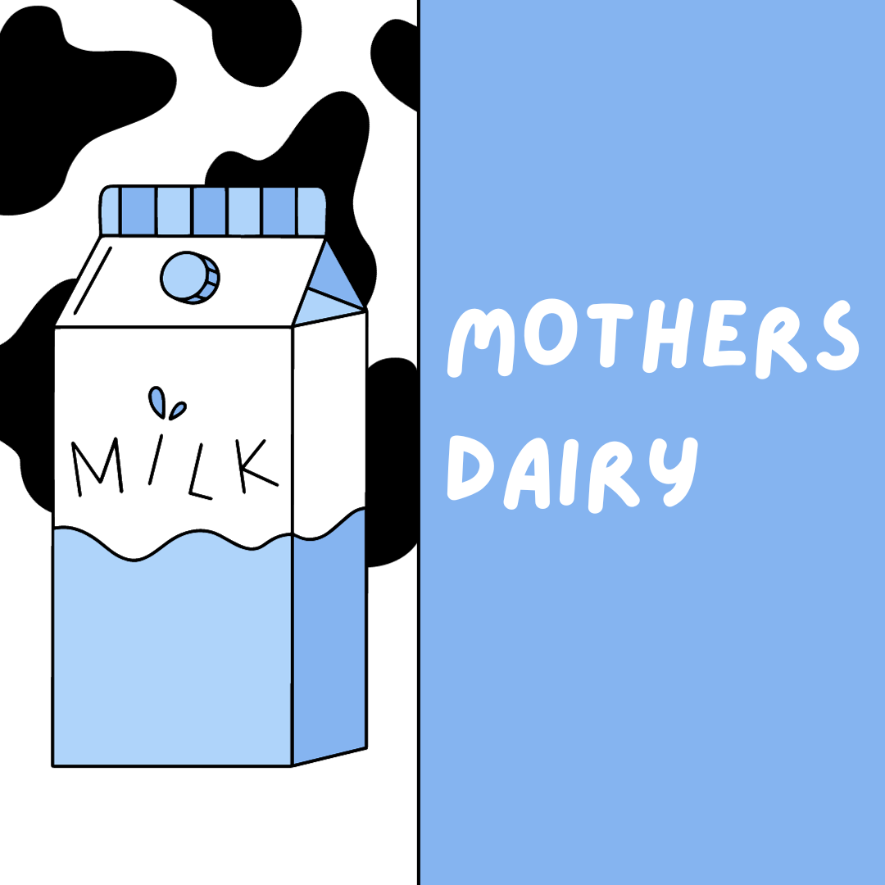
Post Creation & Designs/Video Editing
Identify three different content formats relevant to the chosen topic or industry. Research and Brainstorm: Research trending topics, industry news, or audience interests within each category. Brainstorm ideas for social media posts that align with each category.
FORMATE 01
FORMATE 02
FORMATE 01
@moth.ersdiary • Instagram photos and videos

Slide 40
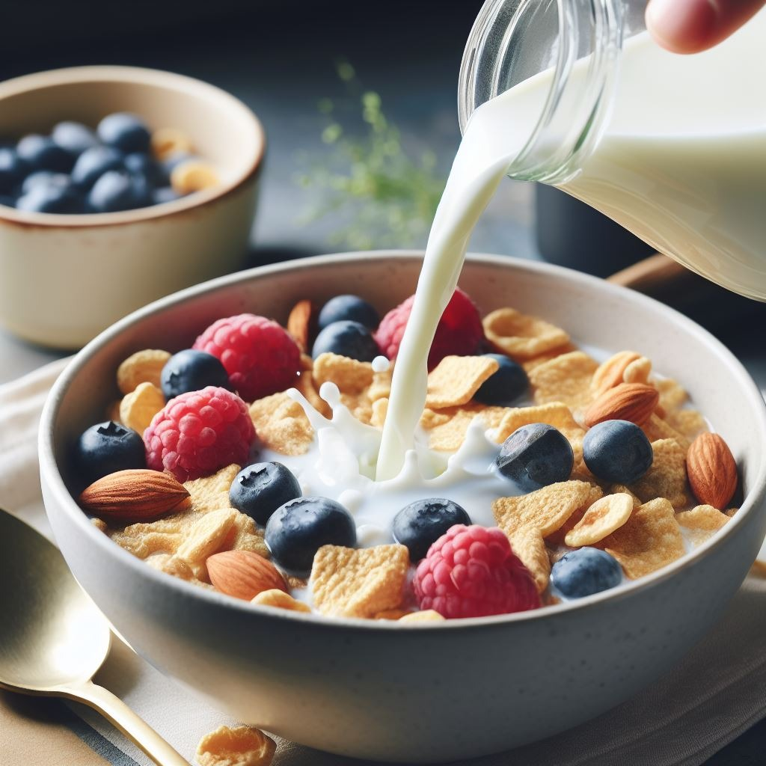
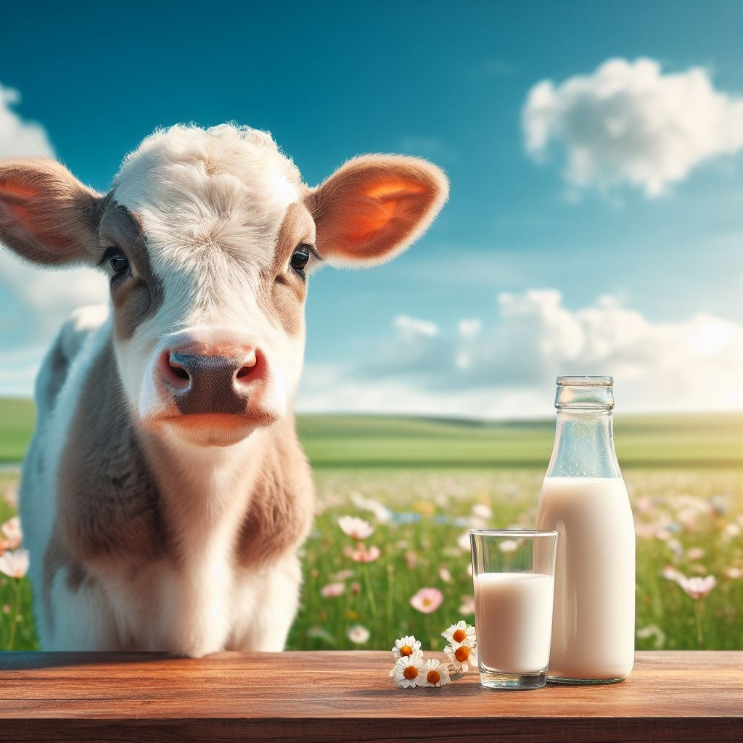
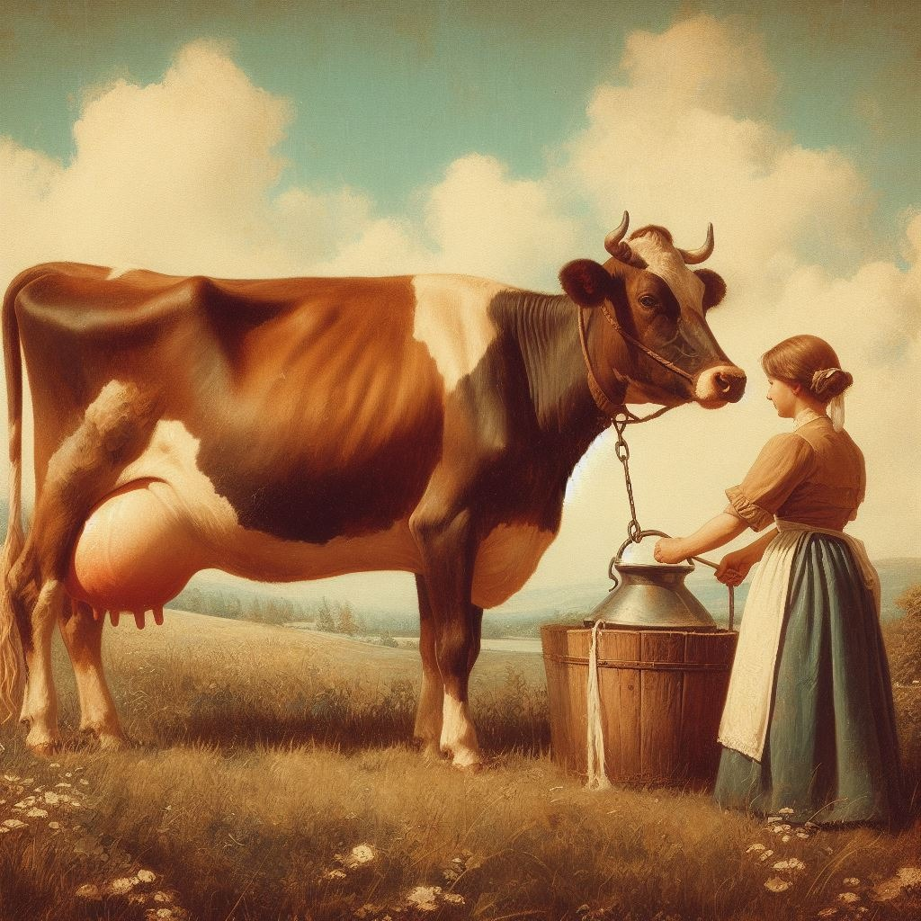
Posted Material
Instagram Page(Tap to Open)

Slide 41
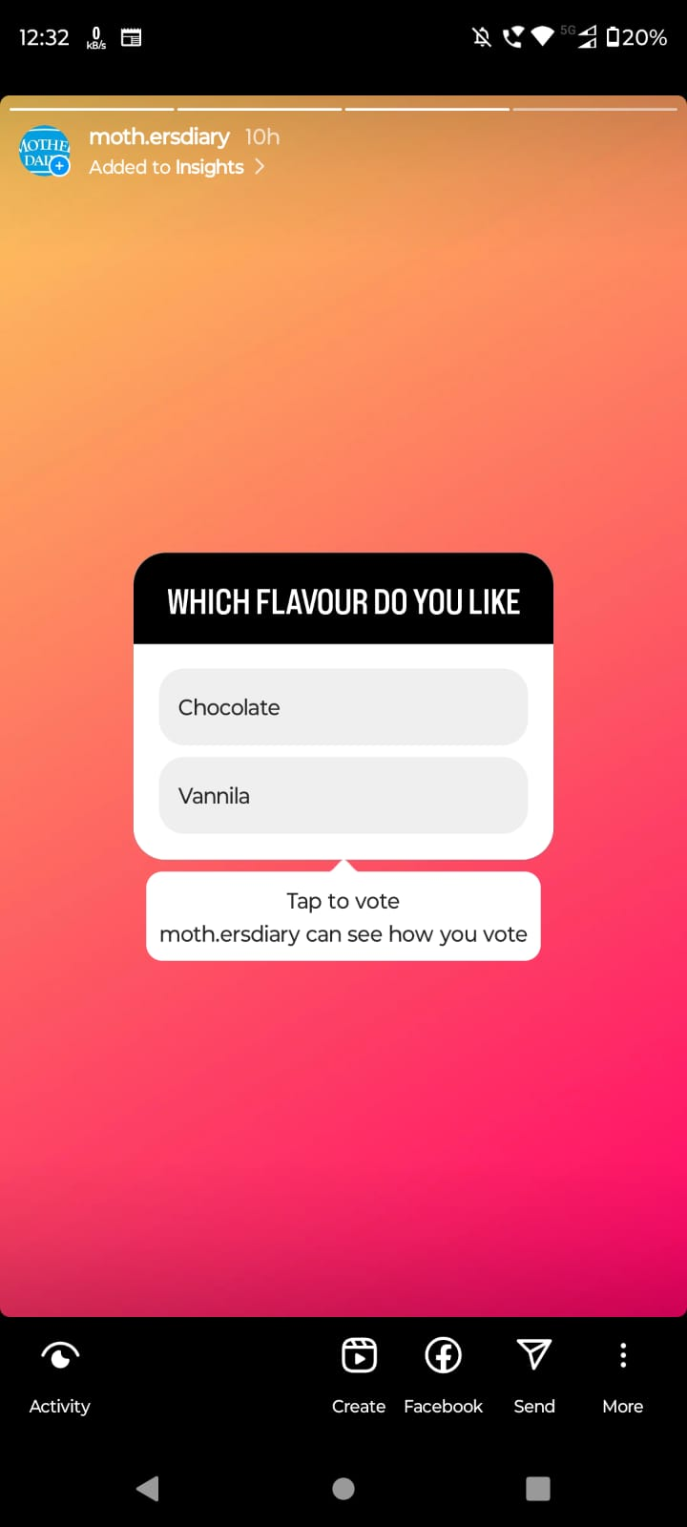
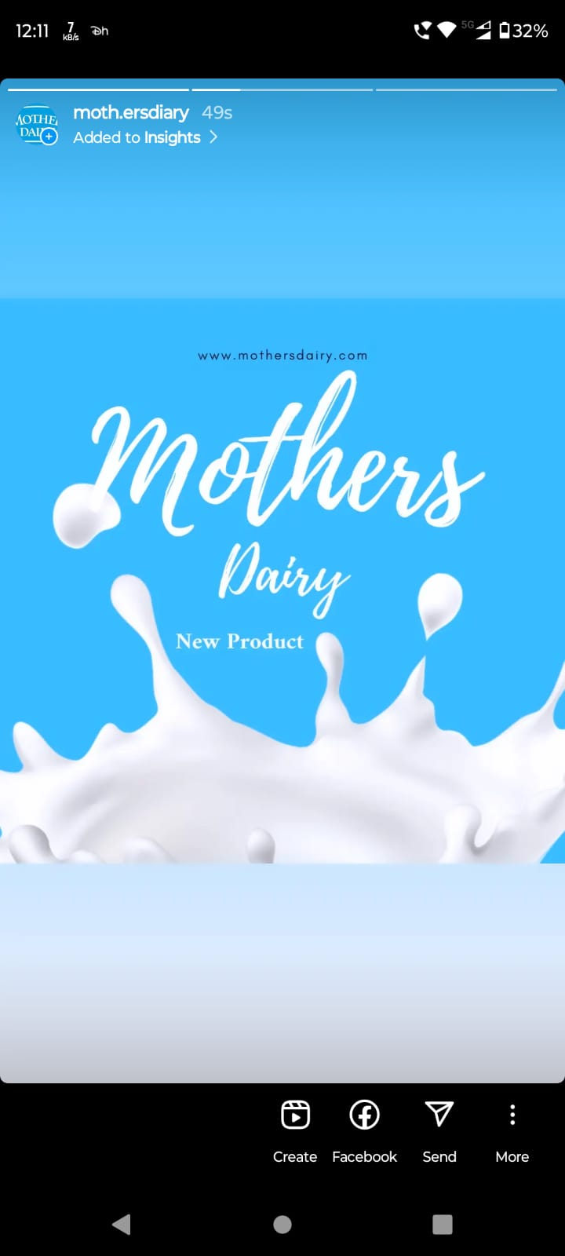
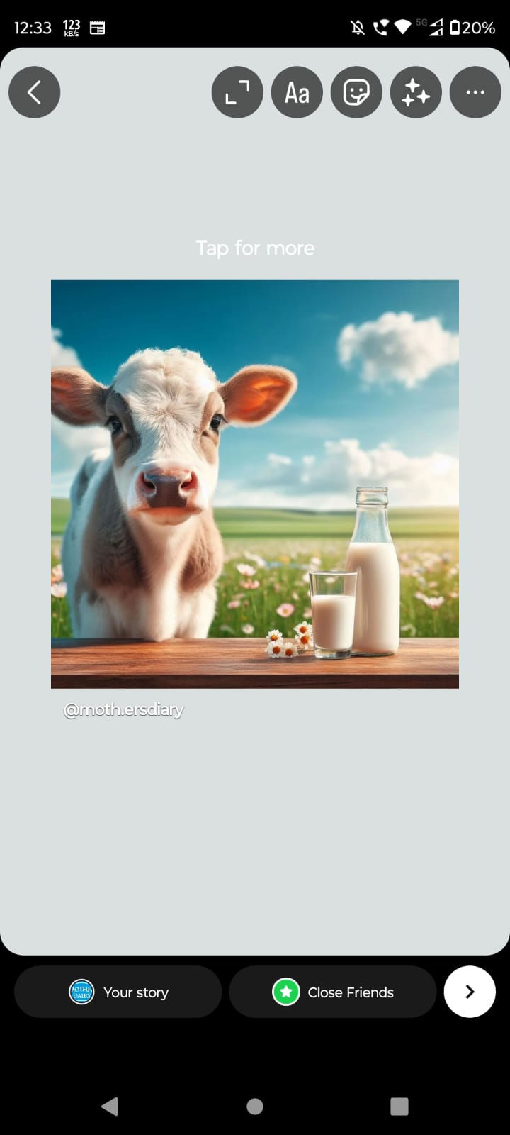
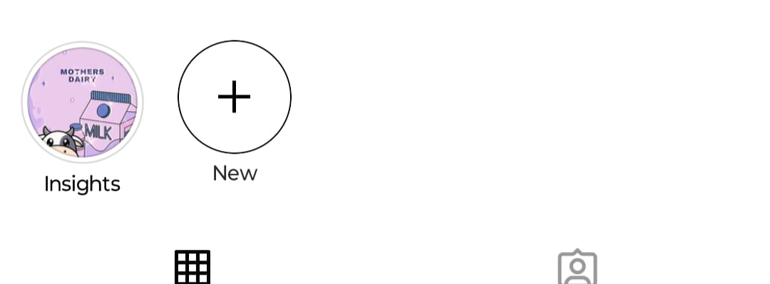
Instagram Story: Utilize the Stories feature on Instagram for three consecutive days. Share behind-the-scenes glimpses, polls, quizzes, or sneak peeks etc to encourage audience participation. Once uploaded use the story highlight feature on Instagram and save the 3 story with an appropriate name for each.
HIGHLIGHTS
INSTAGRAM STORY

Slide 42

Designs/Video Editing
@moth.ersdiary • Instagram photos and videos
Tap On Screen To watch the Video

Slide 43

Social Media Ad Campaigns
1
Ad campaigns over social media
Come up with 3 ad campaigns each covering one of the mentioned goals: brand awareness, driving website traffic, or generating leads
For every campaign clearly define:
Advertising Goals: increasing brand awareness, driving website traffic, or generating leads.
Audience Targeting: Define the target audience for the ad campaigns based on demographics, interests, and behavior.
Ad Creation: Create visually appealing ad creatives, compelling ad copy and relevant call-to-action.
2
3

Slide 44
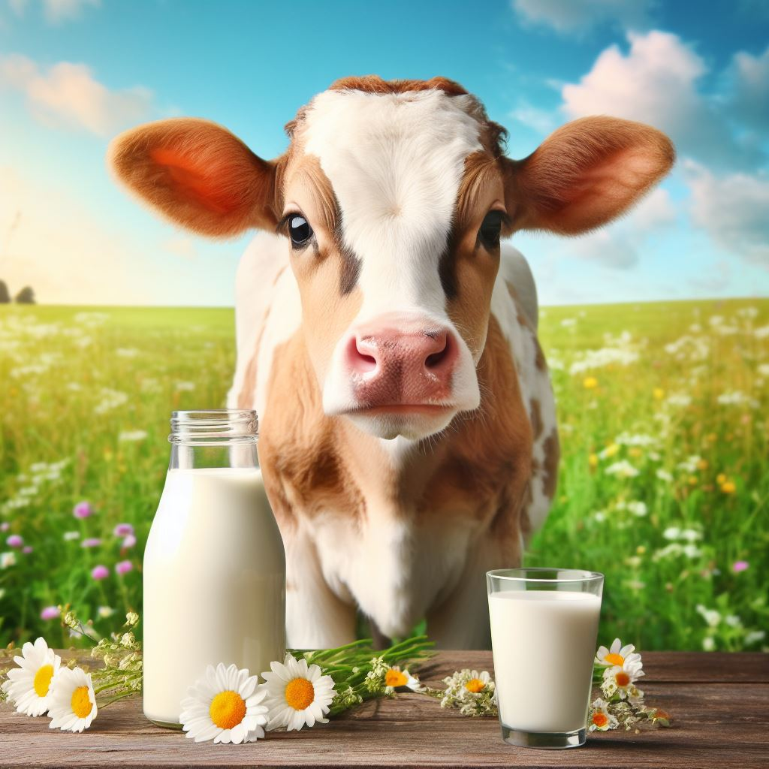
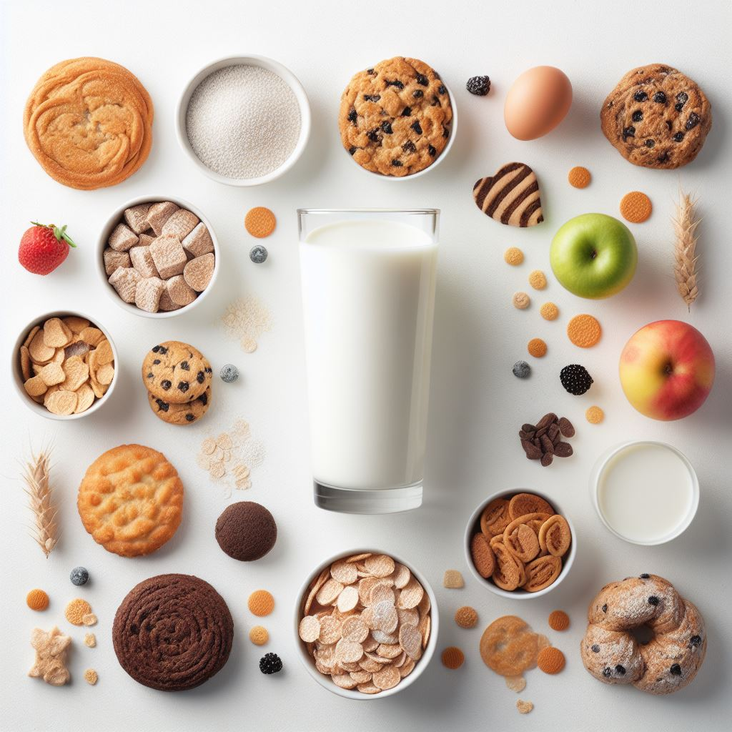

Image Ads with Related Description
1
Ad campaigns
2
Ad campaigns
3
Ad campaigns
"Mother's Dairy: Nourishing families, one glass at a time."
"Mother's Dairy: The Taste of Love in Every Sip."
"Mother's Dairy: Nourishing homes, one glass at a time."

Slide 45
Conclusion
Thanks for providing is golden opportunity to perform this for Power point presentation and a very thanks for SMARTBRIDGE for providing this internship
From
K.Jagan Mohan Faculty Member
Team Members
Kolasani Nikhil
Vinnakota Harika
Kollu Sowmya Vani
Yeruva Sai Bala Dharaneswar

